Slide 1
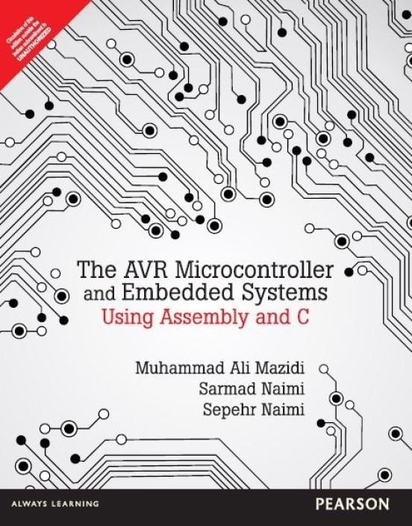
Introduction to AVR

Slide 2
Topics
Microprocessors vs. Microcontrollers
Most common microcontrollers
AVR Features
AVR members

Slide 3
Microprocessors vs. Microcontrollers
Microprocessors (General Purpose)
Microcontrollers

Slide 4
Why Microcontroller
Microcontrollers are important part of Embedded
Systems
To understand structure and working of
microcontroller
For designing good Embedded system complete
understanding of microcontrollers is required.

Slide 5
Microcontroller
Integrated chip that typically contains integrated CPU, memory(RAM,ROM),I/O ports on a single chip
Basically system on chip
Designed to execute specific task to control a single system

Slide 6
AVR Microcontroller
AVR stands for Advanced Virtual RISC
the founders are Alf Egil bogen Vegard wollen RISC
AVR architecture was conceived by two students at Norwegian institute of Technology and further refined by Atmel Norway.

Slide 7
RISC Advantages
Fast execution of instructions due to simple instructions for CPU
RISC requires fewer transistor which makes the design cheaper.
Emphasis on software
Single clock instructions only
Register to Register: LOAD and STORE are independent instructions

Slide 8
AVR Microcontroller
A series of 8-bit RISC microcontrollers from Atmel.
All AVR microcontroller share same instruction set basic CPU(Harvard) architecture
It has 32, 8bit general purpose registers.
Mostly instructions get executed in single cycle.

Slide 9

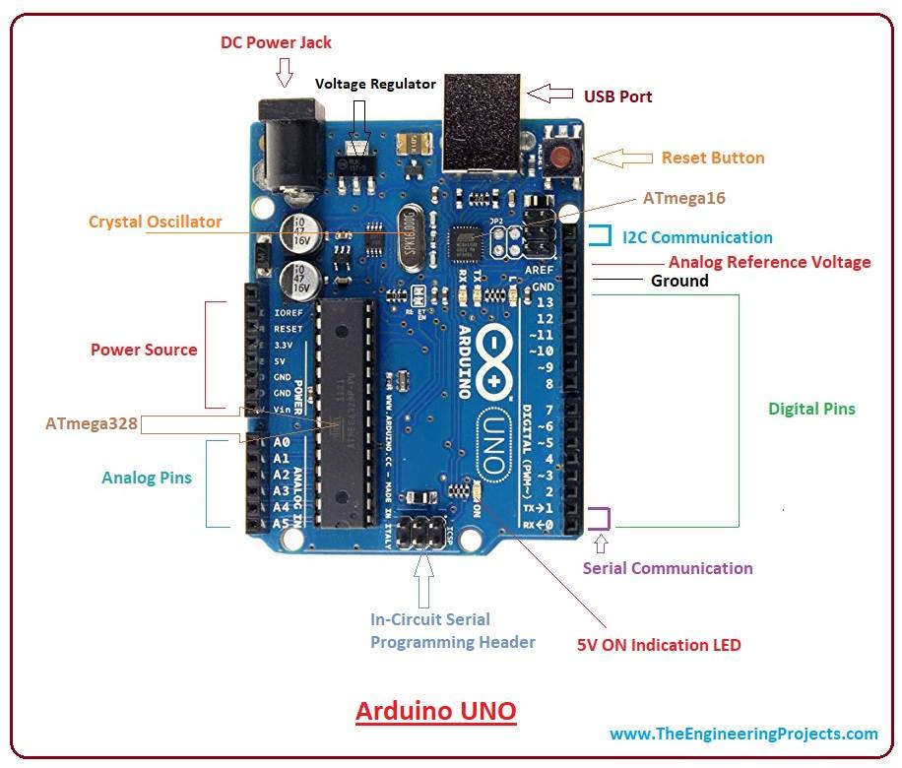
AVR Which you have already learnt
Operating Voltage: 5V
Input Voltage : 7v to 12V
14 Digital I/O pins
6 Analog I/O pins
Flash Memory is 32 KB
SRAM is 2 KB
EEPROM is 1 KB
CLK Speed is 16 MHz
DC Current for I/O pins is 40 mA
DC Current for 3.3V Pin is 50 mA

Slide 10
AVR Types
Classic AVR
e.g. AT90S2313, AT90S4433
Mega
e.g. ATmega328, ATmega32, ATmega128
Tiny
e.g. ATtiny13, ATtiny25
Special Purpose AVR
e.g. AT90PWM216,AT90USB1287
XMega
New features like DMA, DAC, crypto engine, etc.

Slide 11
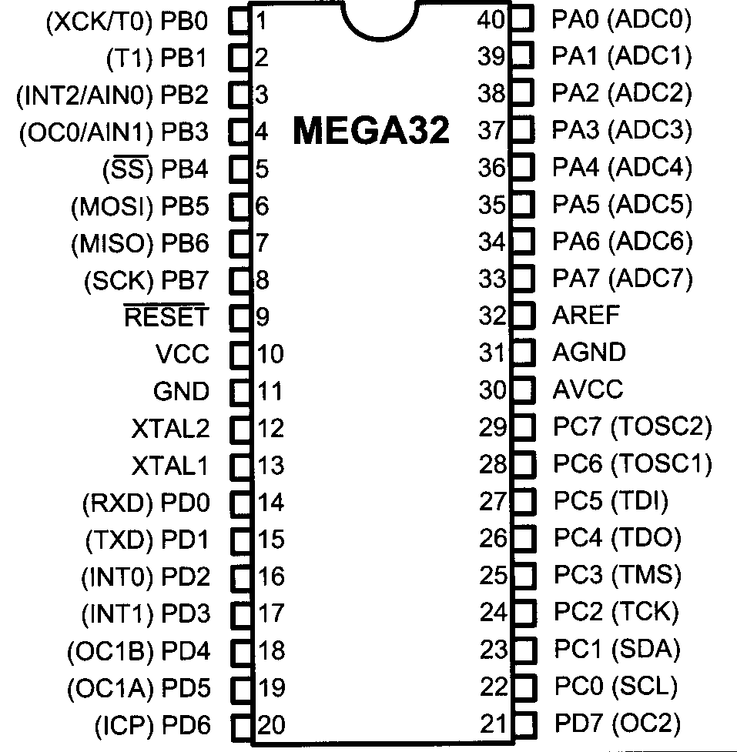
AVR internal architecture

Slide 12
AVR’s CPU
AVR’s CPU
It’s an 8-bit Microcontroller
ALU
32 General Purpose registers (R0 to R31)
PC register
Instruction decoder
CPU
ALU
R0
R1
R2
…
SREG:
H
N
Z
I
T
S
V
C
R15
R16
R17
PC
…
Instruction decoder
R30
R31
Instruction Register
registers

Slide 13
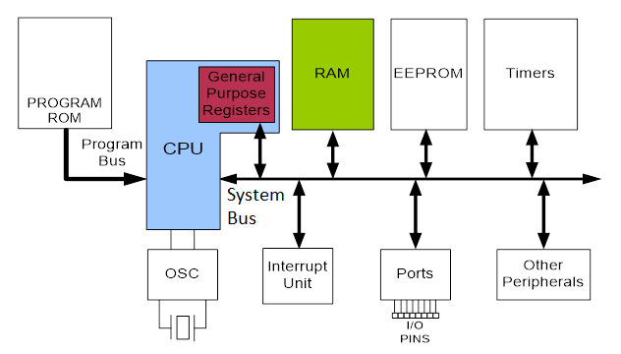
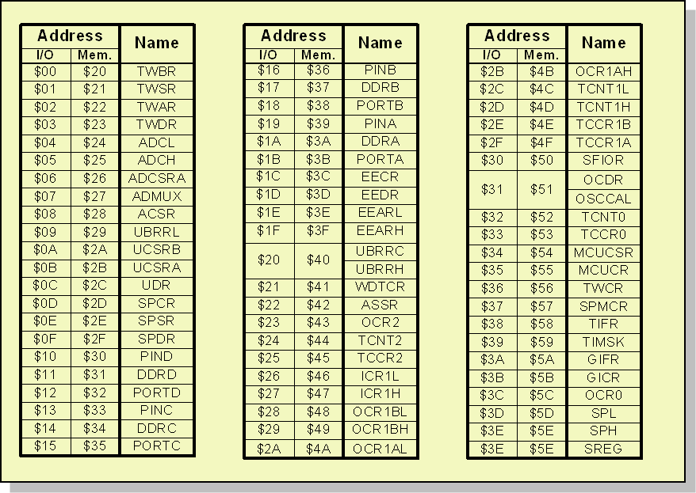
Data Address Space

Slide 14
AVR Ports
ATmega32 ports are 8-bit SFRs
Port A, Port B, Port C and Port D
Configurable as
Input Port
Output Port
Alternate Function

Slide 15
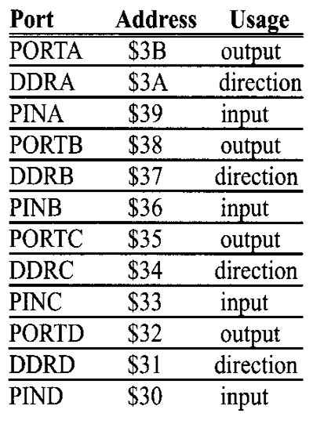
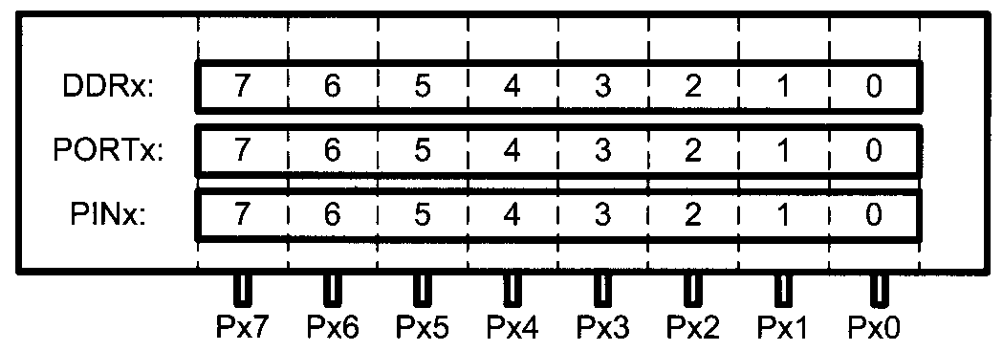
Port Register Functions
Port has 3 registers (8-Bit each)
PORTx (Output Data)
DDRx (Direction of Data)
PINx (Input Data)

Slide 16
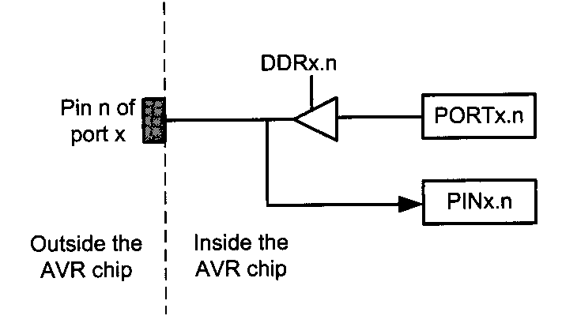
Port Internal Structure
Upon reset, all ports have the value 0x00 in their DDR registers. This means that all ports are configured as input

Slide 17
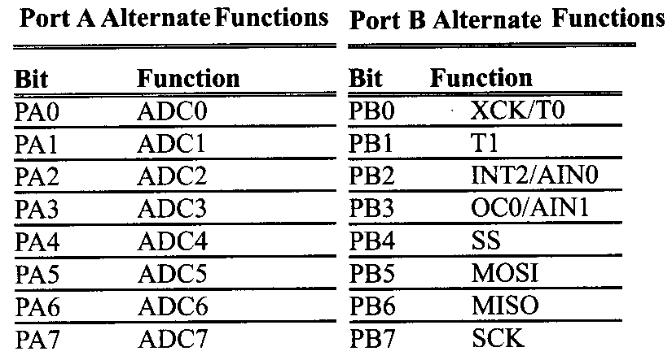
Alternate functions of Port A and Port B

Slide 18
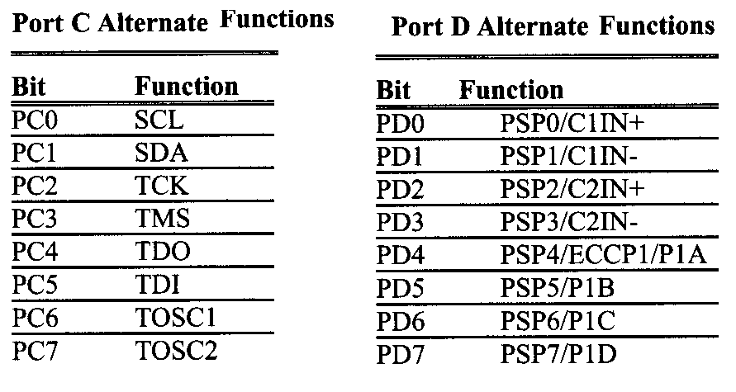
Alternate functions of Port C and Port D

